Slide 1

Final Presentation - Business Intelligence Strategy Pitch
Big Data Analytics – BDAT1009
Enterprise Analytics
Tilak Pandya (200534318)
Namra Patel (200535046)
Yuvrajsinh Gohel (200556632)
Binay Patel (200558474)

Slide 2
Background Information
Dataset Significance:
Key dataset on e-commerce customer behavior.
Holds demographics, transactions, and feedback.
Strategic Insights:
Vital for informed decision-making.
Optimizes online platform for user experience.
Business Growth:
Identifies patterns for targeted marketing.
Enables personalized recommendations.
Competitive Edge:
Leverages data for enhanced competitiveness.
Focus on customer satisfaction for success in e-commerce.

Slide 3
Strategy Development
SMART Objectives and KPI:
Objective: Increase online sales revenue by 15% within the next fiscal year.
Key Performance Indicator (KPI): Percentage growth in online sales revenue.
Objective: Improve customer retention by implementing a loyalty program, resulting in a 20% increase in customer retention rates over the next two quarters.
KPI: Customer retention rates measured quarterly.
Objective: Enhance website user experience by reducing page load times by 20% to increase overall customer satisfaction.
KPI: Average page load time on the website.
Objective: Expand market reach by acquiring 30% more customers from a new target demographic within the next six months.
KPI: Percentage increase in customer acquisition from the new target demographic.
Objective: Optimize marketing campaigns by achieving a 25% click-through rate (CTR) through personalized and targeted email campaigns.
KPI: Email campaign CTR.

Slide 4

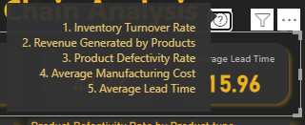
Analyze and Visualize
Card Visual:
Description:
Inventory Turnover Ratio: Display the current turnover Ratio
Revenue By Products: Show the total Revenue generated by all products
Average Manufacture Cost: Display the average manufacturing cost per product
Product Defectivity Rate: Present the current Product Defectivity Rate
Average Production Time: Display the average time taken to produce a product

Slide 5
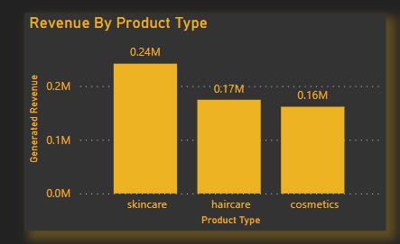
Clustered Column Chart:
Visual Representation:
The clustered column chart visually represents the revenue generated by different product types. Each product type has its set of columns, and the height of each column corresponds to the revenue it generated.

Slide 6
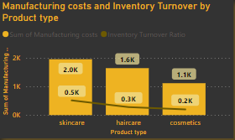
Line and Clustered Column Chart:
Visual Representation:
The line and clustered column chart combine two types of visualizations to represent both the Inventory Turnover ratio and Manufacturing costs for each product type.

Slide 7
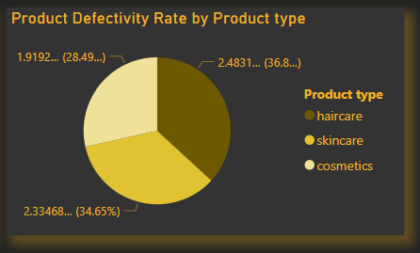
Pie Chart:
Visual Representation:
The pie chart represents the distribution of defectivity rates among different product types.
Slices: Each product type is represented by a slice of the pie.
Size of Slices: The size of each slice corresponds to the defectivity rate of the respective product type.

Slide 8
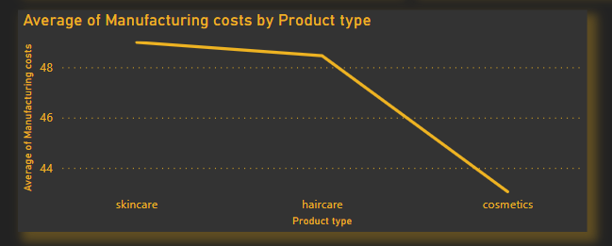
Line Chart:
Visual Representation:
The line chart illustrates the trend in average manufacturing costs across different product types.

Slide 9
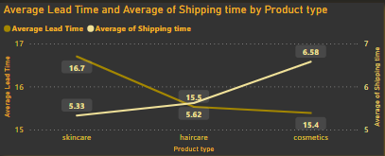
Line Chart:
Visual Representation:
The line chart illustrates the relationship between the average Lead time and the average of shipping time for different product types.

Slide 10
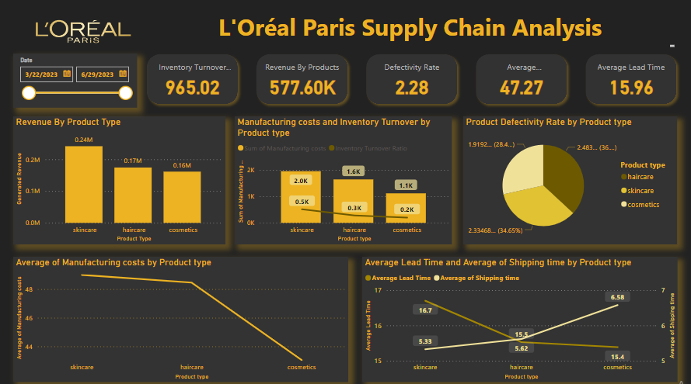

Slide 11
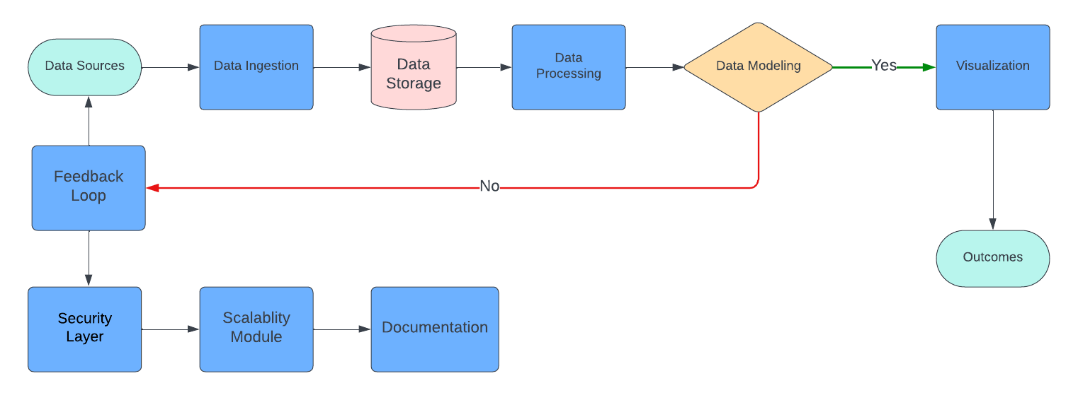
Data Flow Diagram
Data Sources: Identify the various sources of data for the company.
Data Ingestion: Use an efficient data ingestion mechanism to collect data from diverse sources.
Data Storage: Design a data storage architecture to store the ingested data.
Data Processing and Analytics: Utilize a processing layer to analyze and derive insights from the stored data.
Data Modeling: Implement a data modeling layer to structure and organize the data for efficient querying and analysis.

Slide 12
Data Flow Diagram
Visualization and Reporting: Choose a visualization and reporting tool to create dashboards and reports.
Feedback Loop: Establish a feedback loop to continuously improve the data pipeline.
Security and Compliance: Integrate security measures throughout the pipeline to ensure data privacy and compliance.
Scalability and Flexibility: Design the architecture to be scalable and flexible to accommodate future data growth.

Slide 13
Recommendations
Optimize Shipping:
Chart insight: Shipping cost variations.
Action: Analyze and streamline logistics for cost reduction.
Production Efficiency:
Chart insight: Diverse production times.
Action: Review processes, automate, and enhance efficiency.
Cost-Effective Manufacturing:
Chart insight: Varying manufacturing costs.
Action: Optimize processes, negotiate with suppliers.
Inventory Management:
Chart insight: Stock levels across products.
Action: Implement dynamic inventory with data-driven forecasting.
Quality Control:
Chart insight: Product defect rates (Pie chart).
Action: Strengthen quality processes, reduce defects.

Slide 14
Questions and Answers
Your feedback is important to us, please ask questions
Thank you

